Slide 1
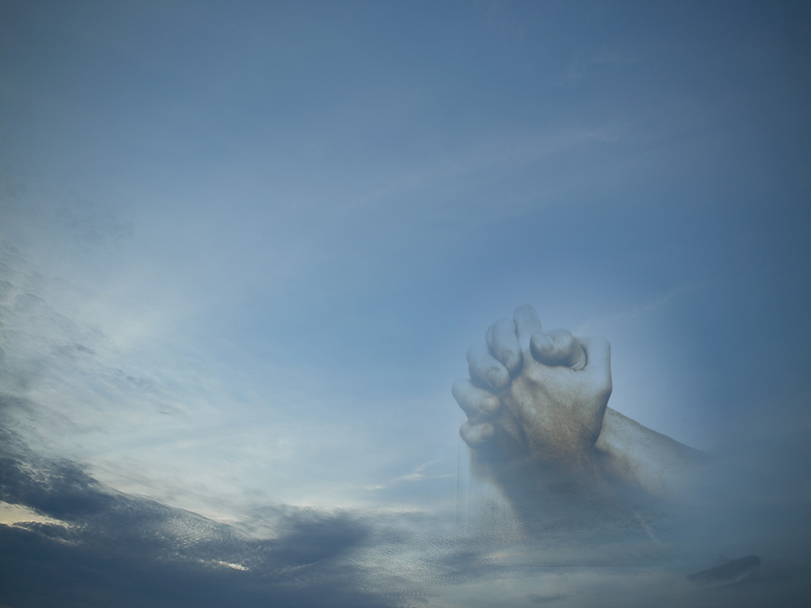
WORSHIP:
Life’s Greatest Moments
Ascribe to the LORD, O families of the peoples,
ascribe to the LORD glory and strength!
Ascribe to the LORD the glory due his name;
bring an offering, and come into his courts!
Worship the LORD in the splendor of holiness;
tremble before him, all the earth!
Psalm 96:7-9

Slide 2
WORSHIP: Life’s Greatest Moments
Scriptural Concept:
God, who is set apart from evil and is holy by nature, identifies with us so as to provide lovingly for our needs. We should worship God in recognition of His greatness and in response to Him as the giver of all good gifts (James 1:17) because of who He is, what He has done, is doing, and will do.

Slide 3
WORSHIP: Life’s Greatest Moments
Scriptural Concept:
Our worship is not based on what we can do for God, but on what He does for us.
Our worship is based on the recognition of His awesomeness and graciousness.
Our worship seeks to do what we can to show our adoration, admiration, devotion and appreciation.

Slide 4
WORSHIP: Life’s Greatest Moments
Scriptural Concept:
Outward expressions unaccompanied by sincerity of heart are empty, meaningless, and worthless to God!
Worship should be vertical & horizontal…
Means it should build relationships with God as well as with each other.
God
One Another

Slide 5
WORSHIP: Life’s Greatest Moments
Scriptural Concept:
God desires corporate worship (Heb.10:25)
Private or family worship is very important to spiritual growth…
But corporate worship provides something the other cannot…
Joint participation in a faith building event which brings a sense of fellowship and mutual encouragement.

Slide 6
WORSHIP: Life’s Greatest Moments
Scriptural Concept:
Our purpose in worship, in addition to appealing to God for blessings, is to make known to Him our innermost thoughts concerning Him…
We are to share our lives with Him.
Our personal benefits are secondary to our need to express to our Creator His worth in our lives.

Slide 7
WORSHIP: Life’s Greatest Moments
Worship is Not…
Every activity in our lives…
We may serve Him through different activities but that is service and not worship.
Luke 17:7-10
Worship involves expressing and sharing with God in ways acceptable to Him (1Pet.2:5) our appreciation for what He means to us.

Slide 8
WORSHIP: Life’s Greatest Moments
Worship includes…
Glorifying God…
Isaiah 60:21b; 61:3b; 66:5; Psalm 22:23; 29:2; 86:12; Matthew 5:16; 9:8, etc.
Expressing Awe…
Psalm 33:8; Matthew 9:8; Hebrews 12:28
Magnifying God…
Psalm 35:27; 40:16; 70:4; Malachi 1:5; Acts 19:17
Honoring Him…
Isaiah 29:13; Rom.1:21; 1Tim.6:16; Rev.4:9,11;5:12,13

Slide 9
WORSHIP: Life’s Greatest Moments
Worship includes…
Reverencing Him…
Psalm 2:11; 5:7; 119:38; Hebrews 12:28
Blessing Him…
Psalm 16:7; 26:12
Praising Him…
Isa.42:8,10,12; Psalm 30:4; 40:3; Lk.19:37; Acts 2:47
Exalting Him…
Psalm 18:46; 21:13

Slide 10
WORSHIP: Life’s Greatest Moments
Worship includes…
Rejoicing in Him…
Psalm 35:9; 63:11; Philippians 4:4
Thanking Him…
Psalm 7:17; 9:1; Luke 17:6; Colossians 3:17

